Slide 1
HYDAKER FURNITURE
By Guided By
Ajmal Rafeeque A K Harsha

Slide 2
synopsis
Hydaker Furniture - An online system for Hydaker furniture located at Calicut.
Hydaker is an innovative application introduced to help furniture sellers and customers.
This application contains buying furniture like table, chairs, couch etc.. along with wooden interiors and decors, wooden floors, ceiling, windows, doors, stairs.
This application provides customers a customization option in which customer can select the wood type and can also customize the product as their need .

Slide 3
This application introduces 3-D view, in which customers gets a 3D view of the product in their .
The wed application comprises 3 modules :
Admin
Staff
Customer

Slide 4
introduction
Hydaker Furniture is an innovative application introduced to help furniture sellers and customers.
This application contains furniture like table, chairs, couch etc.. along with wooden interiors and decors, wooden floors, ceiling, windows, doors, stairs.
This application provides customers a customization option in which customer can select the wood type and can also customize the product as their need
This application introduces 3-D view, in which customers gets a 3D view of the product

Slide 5
OBJECTIVES
Provides a convenient way to search and buy products online.
This web application provides 3D image of the product.
Customers can customize the products.
Customers can track their order.
Staff manages the products, orders and delivery updates.
Admin can view all the details and manage staff.

Slide 6
EXISTING SYSTEM
The existing system is manual. The shop is using forms and normal paper pen method to store the order details and other information.
Loss of order details totally effects the order.
Occurrence of human error.
Difficult to maintain.
Time consuming.

Slide 7
FEASIBILITY STUDY
Feasibility study is defined as the practical extend to which project can be performed successfully.
There are three types of feasibility studies are mainly considered.
Technical Feasibility
Operational Feasibility
Economic Feasibility

Slide 8
Technical Feasibility
The system is effective and requires minimum of hardware and software at less cost and with more efficiency . Also data can be easily stored and retrieved. Hence it is technically feasible.
Economic Feasibility
There is no need for the initial expense with this project. Required resource achieved in minimum cost and minimum time. Hence it can be said that, this package is economically feasible.
Operational Feasibility
Operational feasibility is the ability to utilize, support and perform necessary tasks of the system. The proposed system provides simple and user friendly interfaces. User can perform all the operations/functionalities of the system. Hence system is operationally feasible

Slide 9
PROPOSED SYSTEM
The proposed system is automated and removes all problems in existing system
Easy to maintain.
Avoid human errors
Time efficient
Customers are provided with a 3D image of the product.
Availability of customization option for online customers.

Slide 10
SYSTEM SPECIFICATION
Hardware Specification
System : Pentium IV 2.4 GHz
Hard Disk : 40 GB
RAM : 512 MB
Software Specification
Operating System :Windows 7 and above
Coding Language :Python, Django
Database :SQLite

Slide 11
TABLE
Tb_Login
Primary key : Lid
Fields | Type | Constraints | Description
L_id | int (10) | primary key | Login id
User_name | varchar (20) | foreign key | User name
Password | varchar(10) | foreign key | Password
User_type | varchar (25) | not null | Type of user

Slide 12
Tb_Registration
Primary key : R_id
Fields | Type | Constraints | Description
R_id | int (10) | primary key | Registration id
First_name | int (20) | not null | First name
Last_name | varchar (20) | not null | Last name
Email | varchar (20) | not null | Email
Phone_number | varchar (10) | not null | Phone number
L_id | varchar (10) | Foreign key | Login id

Slide 13
Tb_Category
Primary key : Ca_id
Fields | Type | Constraints | Description
Ca_id | int (10) | primary key | Category id
Name | varchar (25) | not null | Name of category
Description | varchar (35) | not null | description

Slide 14
Tb_Product
primary key: P_id
Fields | Type | Constraints | Description
P_id | varchar(10) | primary key | product id
Name | varchar (25) | not null | Product name
Photo | image | not null | Image of product
Price | decimal (10) | not null | Price of product
Description | varchar (50) | not null | description
Is_available | boolean | not null | availability
Created_date | date-time | not null | Created date
Stock | int(5) | not null | stock
Dimension | varchar (35) | not null | Dimension
Ca_id | Varchar(10) | foreign key | Category id

Slide 15
Tb_Cart
primary key : C_id
Fields | Type | Constraints | Description
C_id | int (10) | primary key | Cart id
Created_date | date-time | not null | Created date
Updated_date | date-time | not null | Updated date
Is_in_order | boolean | not null | Product is in order or not
R_id | varchar(10) | foreign key | Registration id

Slide 16
Tb_Cart item
primary key : Ci_id
Fields | Type | Constraints | Description
Ci_id | int (10) | primary key | Cart-item id
Price | decimal(10) | not null | Price of product
Quantity | int (5) | not null | Quantity
C_id | varchar(10) | foreign key | Cart id
P_id | varchar(10) | foreign key | product id

Slide 17
Tb_Order
primary key : Order_id
Fields | Type | Constraints | Description
Order_id | int (10) | primary key | Order id
House name | varchar (15) | not null | Name of the house
Street | varchar (10) | not null | Street name
City | varchar (10) | not null | City
Pin_code | int (10) | not null | Postal code
state | varchar (20) | not null | State
Country | varchar (15) | not null | country
Created_date | date-time | not null | Order created-date
Updated_date | date-time | not null | Order updated-date
Paid | boolean | not null | Is paid or not
Status | varchar (10) | not null | Status of the order
R_id | varchar (10) | foreign key | registration id

Slide 18
Tb_Order item
Primary key :O_id
Fields | Type | Constraints | Description
O_id | int (10) | primary key | Order item id
Price | decimal(10) | not null | Price
Quantity | int (5) | not null | Quantity
Order_id | varchar (10) | foreign key | Order id
P_id | varchar (10) | foreign key | Product id
C_id | varchar (10) | foreign key | Cart id

Slide 19
Tb_wishlist
Primary key : Wid
Fields | Type | Constraints | Description
W_id | varchar(10) | primary key | Wish_list id
Created_date | date-time | not null | Created date
Updated_date | date-time | not null | Updated date
R_id | Varchar(10) | foreign key | Registration id
Wi_id | varchar(10) | foreign key | Wish _list item id

Slide 20
Tb_wish_list item
Primary key : Wiid
Fields | Type | Constraints | Description
Wi_id | varchar(10) | primary key | Wish list item id
P_id | varchar(10) | not null | product id

Slide 21
Tb_Payment
Primary key : Pa_id
Fields | Type | Constraints | Description
Pa_id | int (10) | primary key | Paymnet id
amount | decimal(10) | not null | Total amount
Is_paid | boolean | not null | Paid or not
Order_id | varchar(10) | foreign key | Order id
R_id | varchar(10) | foreign key | registration id

Slide 22
Tb_wood
Primary Key :Wdid
Tb_Color
Primary Key : Clid
Fields | Type | Constraints | Description
Wd_id | varchar(10) | primary key | Wood id
Wood_type | varchar(25) | not null | Type of wood
Fields | Type | Constraints | Description
Cl_id | varchar(10) | primary key | color id
Color | varchar(10) | null | Color

Slide 23
Tb_Material
Primary Key :Mid
Tb_Foam
Primary Key : Foid
Fields | Type | Constraints | Description
M_id | varchar(10) | primary key | Material id
Material_type | varchar(25) | not null | Type of material
Fields | Type | Constraints | Description
Fo_id | varchar(10) | primary key | Wood id
Foam_type | varchar(25) | not null | Type of foam

Slide 24
Tb_Polish
Primary Key :Poid
Tb_Dimension
Primary Key : Did
Fields | Type | Constraints | Description
Po_id | varchar(10) | primary key | Polish id
Polish_type | varchar(25) | not null | Type of polish
Fields | Type | Constraints | Description
D_id | Varchar(10) | Primary Key | Dimension id
Dimension | Varchar(25) | Not null | Dimension of the product

Slide 25
Tb_Customize
Primary key : Cuid
Fields | Type | Constraints | Description
Cu_id | varchar(10) | Primary key | Customize id
P_id | varchar(10) | foreign key | Product id
Wd_id | varchar(10) | foreign key | Wood id
Cl_id | varchar(10) | foreign key | Color id
M_id | varchar(10) | foreign key | Material id
D_id | varchar(10) | foreign key | Dimension id
Po_id | varchar(10) | foreign key | Polish id
Fo_id | varchar(10) | foreign key | Foam id

Slide 26
Tb_Customize order
Primary key : Coid
Fields | Type | Constraints | Description
Co_id | int (10) | primary key | Customize order id
House_name | varchar (15) | not null | Name of the house
Street | varchar (10) | not null | Street name
City | varchar (10) | not null | City
Pin_code | int(10) | not null | Postal code
state | varchar (20) | not null | State
Country | varchar (15) | not null | country
Paid | boolean | not null | Is paid or not
Status | varchar (10) | not null | Status of the order
Adv_pay | Decimal(10) | not null | Advance payment
E_del | Date-time | not null | Expected delivery
Quantity | Int(5) | Not null | quantity
Cu_id | Varchar(10) | Foreign key | Customize id
R_id | varchar (10) | Foreign key | registration id

Slide 27
Tb_Advance payment
Primary Key : Apid
Fields | Type | Constraints | Description
Ap_id | varchar(10) | primary key | Advance payment id
Amount | decimal(10) | not null | Advance amount
R_id | varchar(10) | foreign key | Registration id
Co_id | varchar(10) | foreign key | Customize order id

Slide 28
Tb_Tracking
Primary key : Tid
Fields | Type | Constraints | Description
T_id | varchar(10) | Primary key | Tracking id
Packed | varchar(10) | not null | Packing details
Packed_date | date-time | not null | packed date
Shipped | varchar(10) | not null | Shipping details
Shipped_date | date-time | not null | Shipped date
Delivered | varchar(10) | not null | Delivery details
Delivered_date | date-time | not null | Delivery date
Order_id | varchar(10) | foreign key | order id
Co_id | varchar(10) | foreign key | customize order id

Slide 29
Tb_Feedback
Primary Key : Feid
Fields | Type | Constraints | Description
Fe_id | int (10) | primary key | Feedback id
Subject | Varchar(20) | not null | Subject
Feedback | Varchar(50) | not null | Feedback
Rating | Varchar(5) | foreign key | Rating of product
R_id | varchar(10) | foreign key | registration id

Slide 30
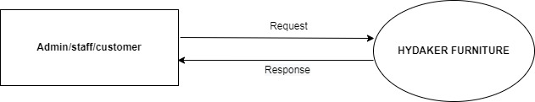
DATA FLOW DIAGRAM
LEVEL O

Slide 31
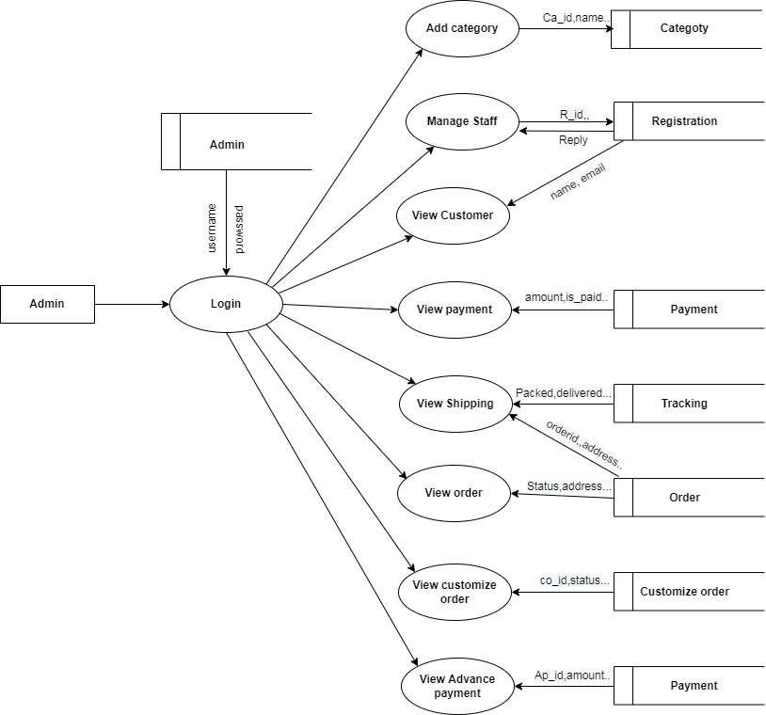
LEVEL 1- Admin

Slide 32
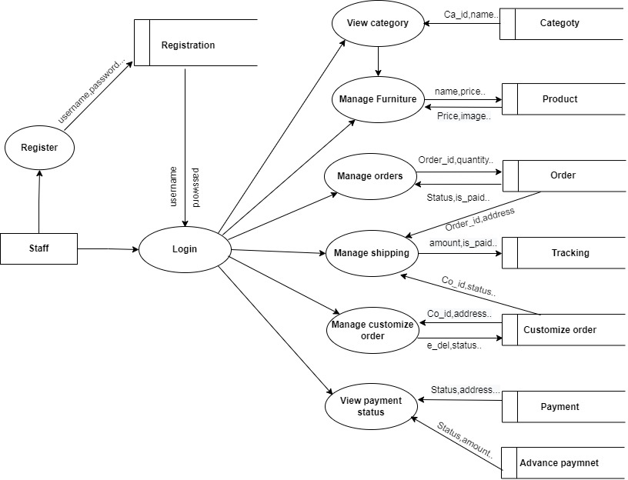
LEVEL 1 - Staff

Slide 33
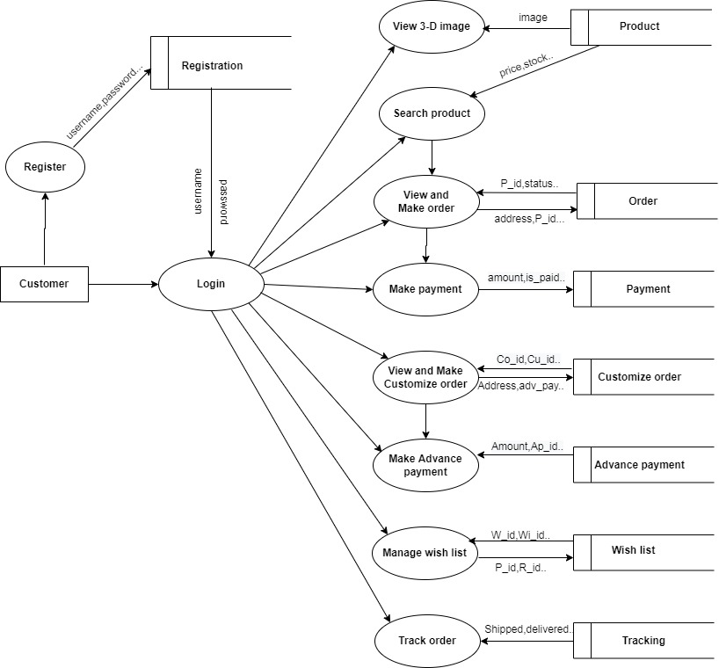
LEVEL 1 - Customer

Slide 34
THANK YOU

